Slide 1
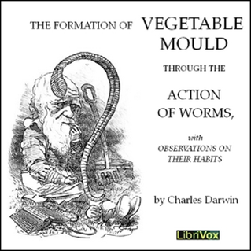

No, Science is NOT Eurocentric!
Jim Clark
Department of Psychology
University of Winnipeg
Winnipeg Manitoba
Canada
North America
Earth
12th Annual International Conference on Social Sciences
ATINER 2025

Slide 2
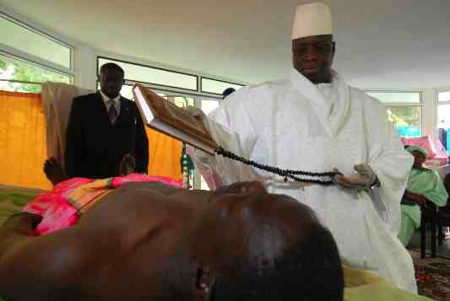
Yahya Jammeh: Former President of Gambia
  Herbal cure for HIV/AIDs: white robe, prayer beads, …
  Revealed by ancestors in a dream
  Family history of African herbalism
  Army colonel, no medical training
Science
  Empirical studies to determine efficacy
  Explain by naturalistic theory (e.g., virus, …)
  Conclusion transcends culture, independent of researcher identity (ξένος, Xenos)

Slide 3
Ethnocentric Views of Science
  “School science conventionally teaches Eurocentric or Western science.” (Aikenhead & Elliot, 2010)
  Critical race theory analyzes “… white epistemology in psychological science … and how scientific racism has been possible in the pursuit of knowledge.” (Teo, 2022)
  “… the colonial sciences … generated ideas of … a hierarchy … with European knowledges at the top.” (Menon, 2022)
  Colorado “refers to traditional Native knowledge … as ‘Native science’ … to place [it] on par with Western science.” (Knudston & Suzuki, 1992).

Slide 4
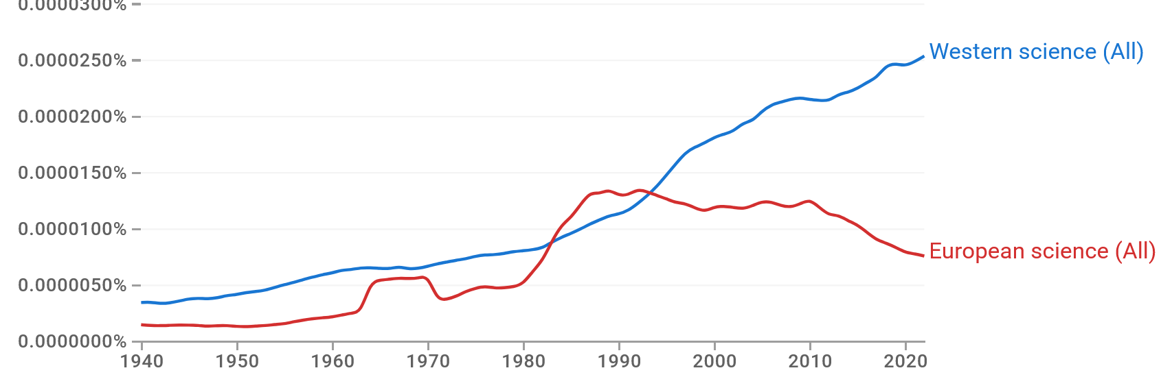
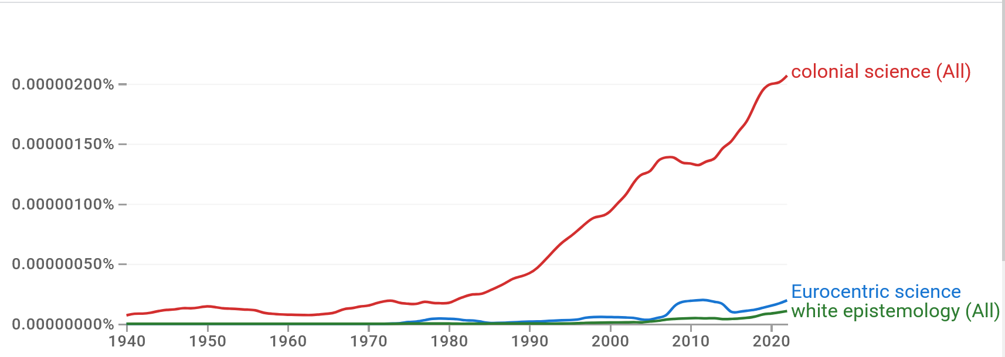
Prevalence?

Slide 5
Science is NOT Eurocentric!
Roots in many cultures
Helped unify Europe
Adopted internationally
Benefits sought universally
Challenged traditional beliefs
Questioned by many in West?

Slide 6
Roots in Many Cultures
Early models focused on proximal factors (“Europe”)
  “Scientific Revolution”
Later enriched history of distal factors (“Global”)
  “Scholars now see the European breakthrough to modernity as the last decisive development in a long series of advances that stretch far back in time and cover much of Eurasia.” (Dawson, 2003)
  Long evolutionary period with roots in many cultures (Montgomery & Kumar, 2016; Poskett, 2023)

Slide 7
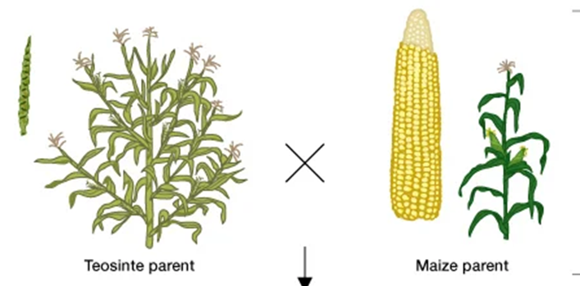
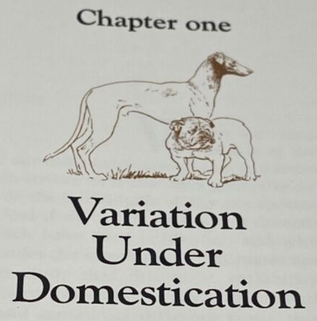
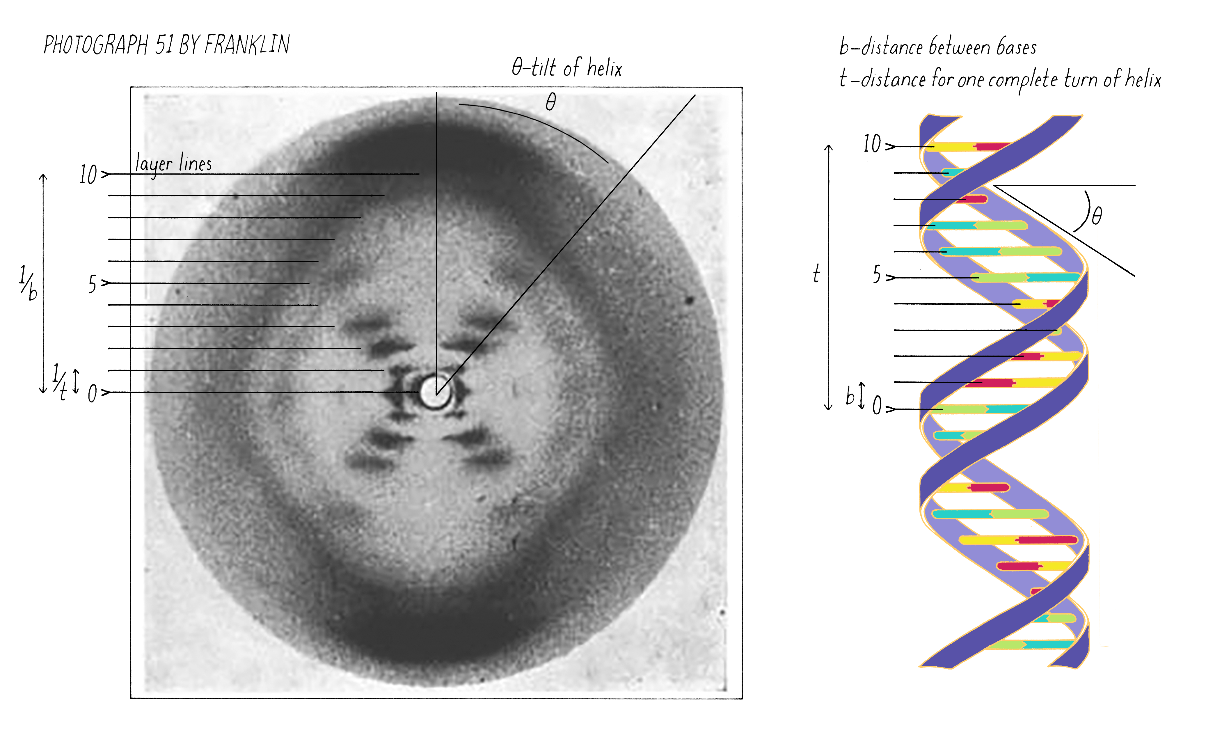
Science builds on pre-scientific knowledge
  Humans globally demonstrate remarkable ability to observe and control their environments
  e.g., selective breeding of Maize/Corn in MesoAmerica
Darwin
  Genetic Science

Slide 8
Helped Unify Europe
“Europe” not a coherent entity, fragmented
  Distinct Ethnicities, Languages, Religions, …
  Conflicts: e.g., 30 Years War (1618-1648)
Scientific “international” correspondence
  Kepler letters to scientists in Germany, Italy (including Galileo), Austria, Czech, Netherlands, UK, France, Belgium, Poland
  Latin a lingua franca (Latinus Scientificus)
Philosophical Transactions published by The Royal Society of England (1665 to today)
  Henry Oldenburg, Editor & Publisher: multilingual German, personal contacts in multiple countries
Science as unifying force
  Science → Europe rather than Europe → Science

Slide 9
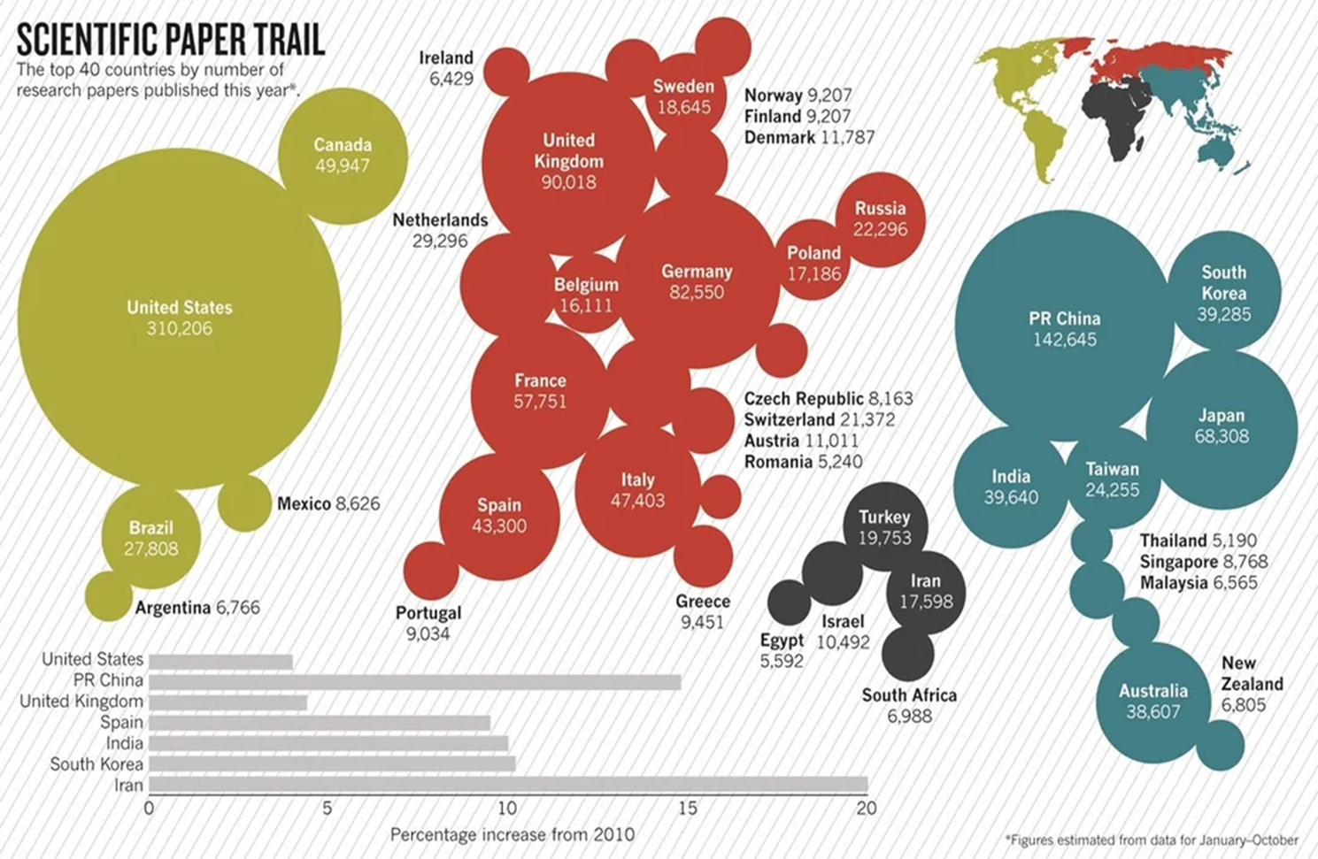
Adopted Internationally
Science served similar unifying framework globally
Darwin: 15,000 letters “with around 2,000 people from all around the world and all walks of life” (Cambridge Digital Library)
Publications

Slide 10
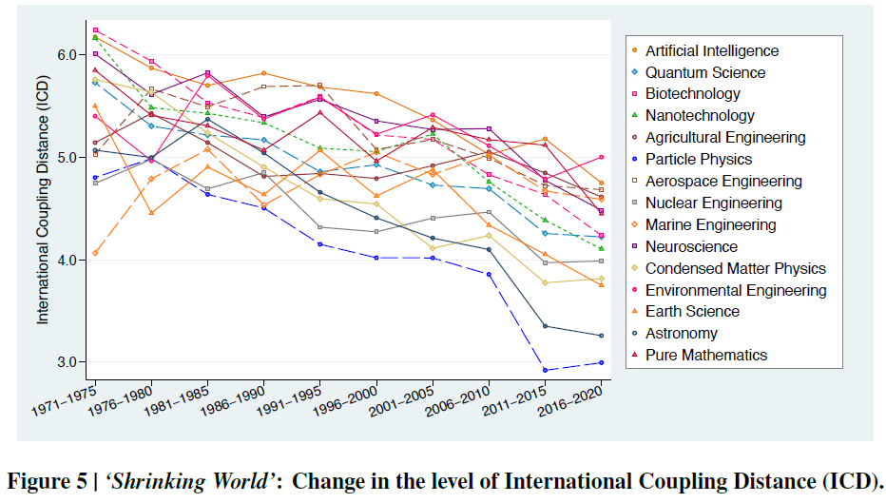
Collaborations
  Higher coupling distance = more distant relationship (Okamura, 2023, A half-century of global collaboration in science and the ‘Shrinking World’.)

Slide 11
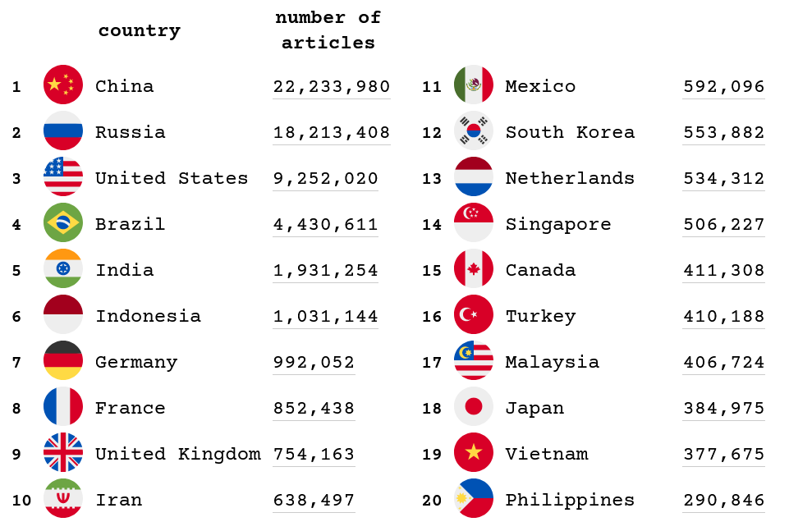
Sci-Hub Use
X
X
X
X
X
X
X
X
X
X
X

Slide 12
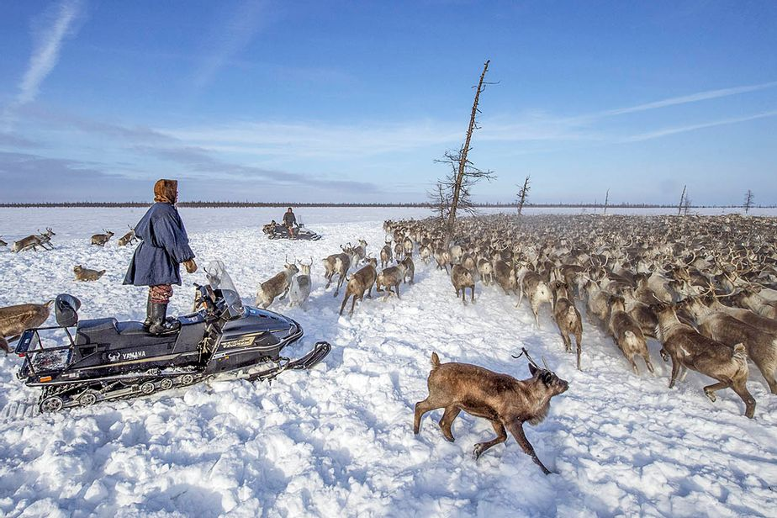

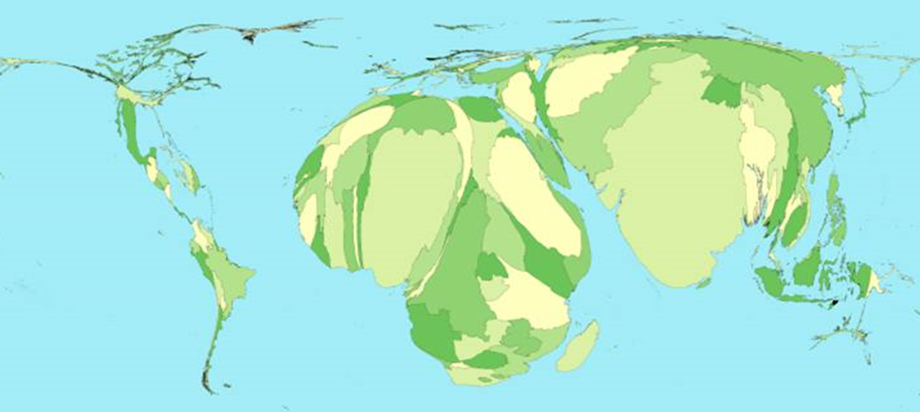
Benefits Sought Universally
Indigenous Populations
  Modern “tools”
Critics of science
  Devices, Internet, …
Unequal Access
  e.g., Science-based healthcare

Slide 13
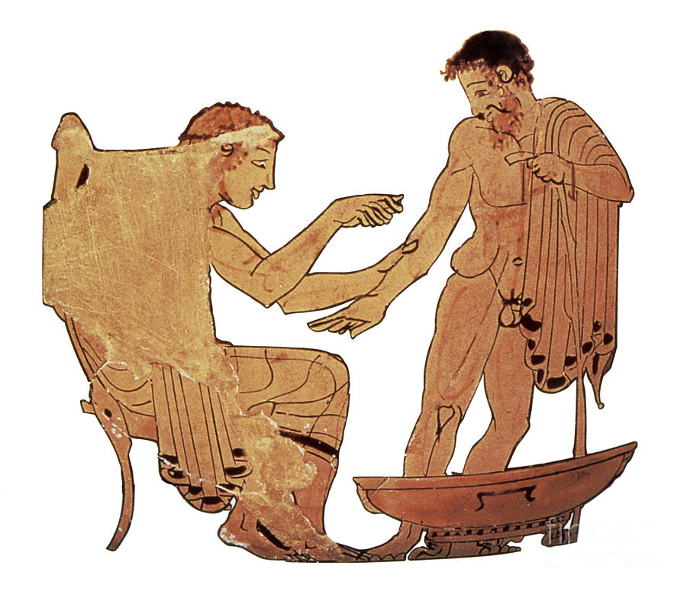
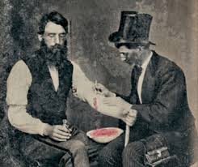
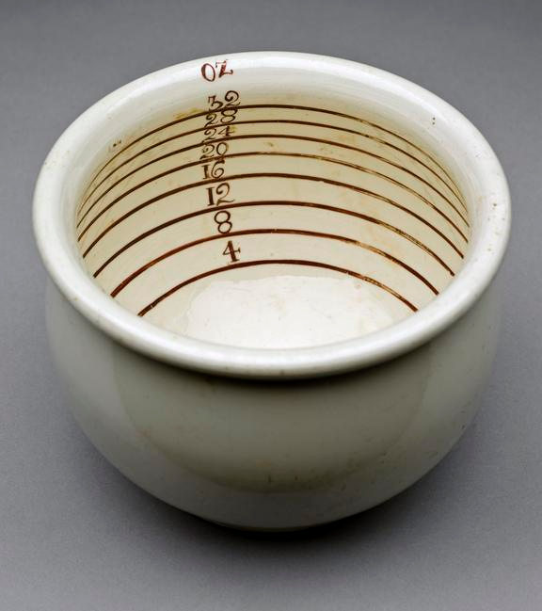


Science & Traditional Beliefs
Science Challenges Traditional Beliefs & Practices
  Blood-letting
  …
“World” NOT Intuitive
  “… world … is not constructed on a common-sensical basis … science requires … awareness of the pitfalls of 'natural' thinking. …lay theories are highly unreliable.” (Wolpert, 1992, The Unnatural Nature of Science)

Slide 14
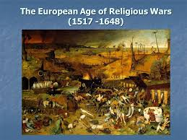
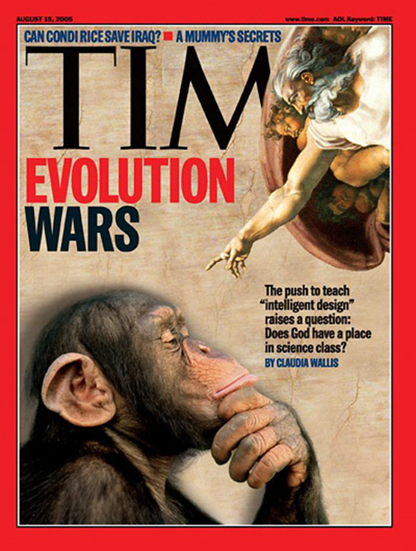
Supranatural beliefs especially vulnerable?
  Universal before science, even in west: Religious wars
  Science provides alternative worldview: e.g., evolution vs creationism
Science & Religion Incompatible?

Slide 15
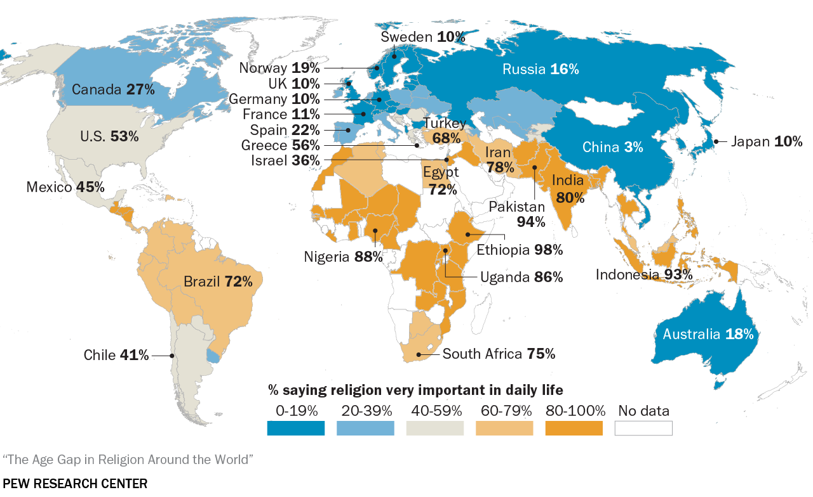
Religion Very Important in Lives

Slide 16
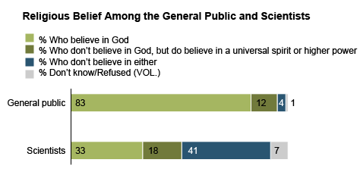
Religious Belief of Scientists

Slide 17
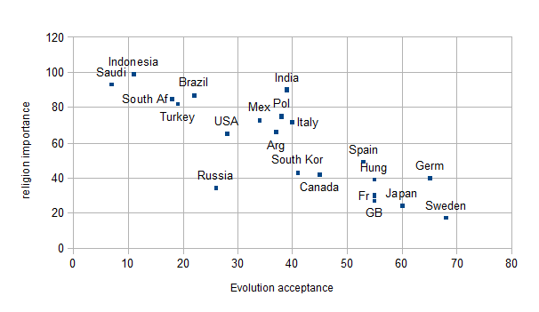
Nations

Slide 18
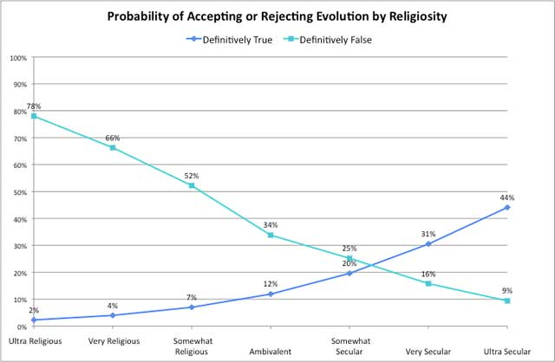
Keysar (2014)
Accept or Reject Evolution by Religiosity
Definitely False
Definitely True
Ultra Religious
Ultra Secular

Slide 19
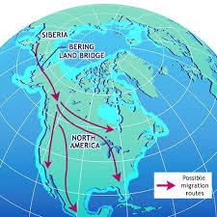
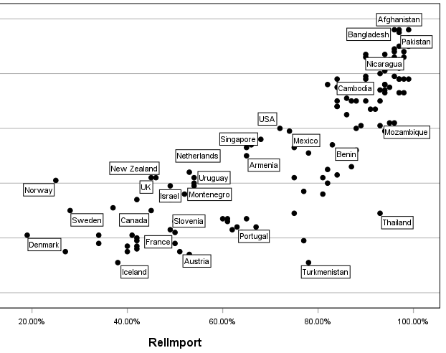
Choose Traditional Belief or Science when Conflict?
  ''There's a real feeling that we've been here forever ... The Bering Strait theory makes logical sense, but … the traditional belief … comes first.‘’ (quoted in Johnson, 1996)
  Religion
Choose Religion if Conflict with Science

Slide 20
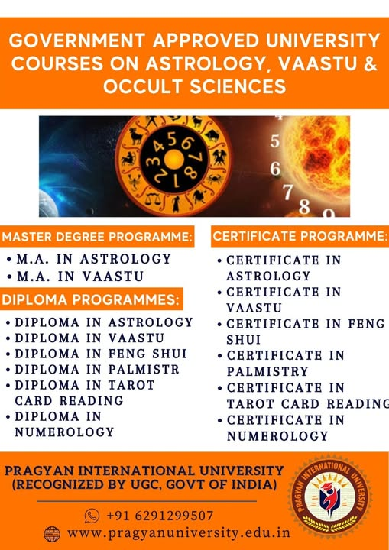

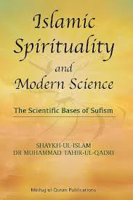
In contrast to science, Ethno Epistemics
  Confirm and promote traditional beliefs: Reactionary
  Vedic “Sciences” and “… university-level courses in astrology.” (Ruparelia, 2006)
  “In most Indigenous epistemologies, knowledge is … spiritual …” (Marsh et al, 2015)
  Journal of Islamic Sciences “… dedicated to … renewed … relationship with the spiritual and intellectual traditions of Islam.”

Slide 21
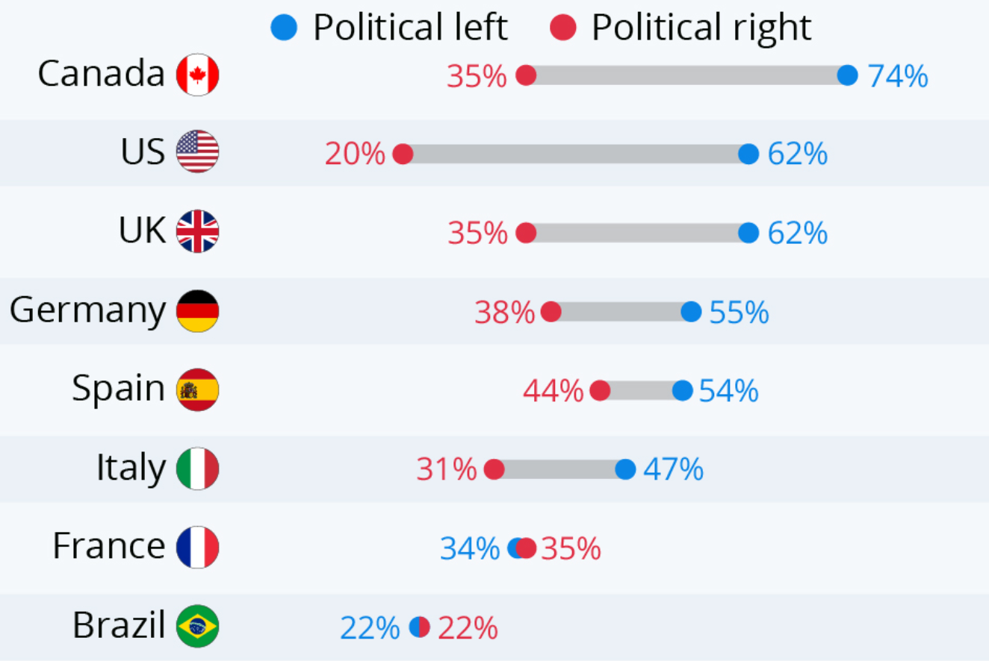
Qualified Support for Science in West
If Eurocentric, expect very high level of trust in science in West
But, science NOT universally valued, including in west
Trust in scientists (Statista, 2019)

Slide 22
Conclusions
In contrast to Ethno Epistemics,
Science is NOT Eurocentric
  Roots in many cultures
  Helped unify Europe
  Adopted internationally
  Benefits sought universally
  Challenged traditional beliefs
  Questioned by many in West?
Science is Universal

Slide 23
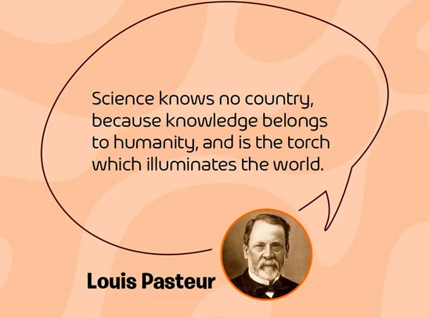
Thanks for Listening!

